Slide 1
ZillionBrain Serving Industry Desires –Experience WOW
Date : 16.04.2024 – R1 www.zillionlink.in

Slide 2
Insight
Establishment Year
01
FY2022 . Inaugurated by Mr. Sunil Dhole ( Wel known scientist ) , Mr. Akimichi Kurihara ( Zenwaves Japan ) & Mr. Sanjay Pawar ( Cyber Security Expert Japan )
What we Do ?
02
EMS Process Trainings , Quality Improvements , Cost reduction ,
Productivity Improvement , QMS Certifications , Induction
Programs , Onjob trainings , 5S , Lean , P&L & TPM assesments ,
implimentation / certifications & Business consultation
@ Electronic Industries
Note : We provide skilled manpower for Electronic Industries

Slide 3
From the desk of CEO
Whether looking to streamline functions for your business or seeking ways to improve the Top Line and Bottom Line of your business?. We have started delivering all these models when our associates decided to make expensive education to more affordable, practical, time efficient and entertaining. Education should not waste your time with knowledge that is only useful in an exam or audits. It should make you better in practice.
In all our educational packages, you will learn the best practices in the application of process and continual improvement methodologies with the objectives of driving sustained transformation and ensuring continuous incremental improvement in your business processes.
Operational Excellence is not a toolbox, it's a way of thinking, living, and acting in a business

Slide 4
Skilling/Upskilling Services
Services | Website Links
Employee Acceleration Program ( EAP ) | https://zillionlink.in/courses/68/balanced-brainiac-part-01 https://zillionlink.in/courses/69/balanced-brainiac-part-02
EMS Boot Camp ( EMSBC ) | https://zillionlink.in/courses/51/module-01-ems-boot-camp
EMS Job Oriented Trainings ( EMSJOT) | https://zillionlink.in/courses/category/29/job-oriented-training
Operational Excellence@ ESDM | https://zillionlink.in/courses/52/module-2-operational-excellence
5S , Lean , P&L & TPM assesments | On demand
EMS Start up program | https://zillionlink.in/courses/53/module-03-start-up-certification
CI Certification Programs . Most selled ＄ | https://zillionlink.in/pdf/171223562577762.pdf
Skilled Manpower Supply | https://zillionlink.in/career

Slide 5
Consultation
Product Innovation
Business Consultation :
Green Energy Solutions
SMART Cities
SMART Health
SMART Agriculture
Plant & Process setup – Electronic
Manufacturing Services
HR policies
Startup Establishment / Incubation support
IATF 16949 : 2016
Mergers & Aquisitions
Project consultation for EMS
BoM Cost reduction
Quality & Kaizen Culture development
Business Development

Slide 6
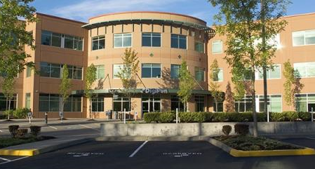
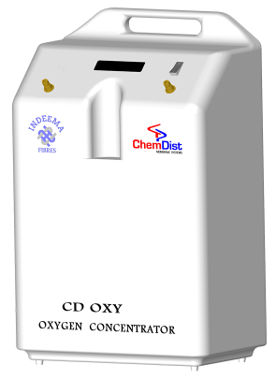
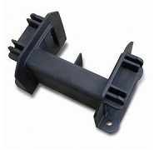
Associations & Advisory bodies
ESSCI – Electronic Sector Skill Council Of India
Yelson Technologies &
Sun C
Incubation support
Chemdist Solutions & IIT Guwahati
Zenwaves Japan
New Product entry
Plastic moulding & Wire harness Mfg Unit - Anuj Industries
Securlichi Solutions
Cyber Security
Megha Embedded Solutions
Sinhgad Industrial Association

Slide 7
Milestones : Last 365 days
2000 +
Satisfied Participants
200 +
Placements
040 +
Projects ( PQCDMS )
008 +
QMS Certifications
002 +
EMS Process setups

Slide 8
Thanks!
Any questions?
You can find me at gajanan@zillionlink.in , connect@zillionlink.in , edu@zillionlink.in
91 860 500 8590
91 914 509 3943
ZILLIONLINK PRIVATE LIMITED
SN NO 44/19, Plot no 4, Office Unit 2, First Floor Darshana Building, Narhe Industrial Estate , Pune, Maharashtra, India, 411041
GSTIN : 27AACCZ0407B1ZU , IEC : AACCZ0407B

Slide 9
About Zillion Group
Brand FLOW dedicated to the training and execution services of Industrial Psychology, Counselling Psychology and Value Education to Electronic Sector.
Brand ZillionBrain offering skilling and upskilling services to Electronic Educational Institutes, Electronic Manufacturing Services and Electronic Start-ups
Brand Zillion Trade is dedicated to trading of electronic components, devices and gadgets for Indian and overseas market
Brand Diago offering Innovative product development services to Indian and overseas market .

