Slide 1
Business Presentation

Slide 2
Insight
Professionally managed operations for Foreign Currency and Indian Rupee business, in order to provide its customers a one-stop sourcing option for all their requirements ranging from electronic active , passive , RF ,Electromechanical Components Displays , waste cotton , safety material & consumables
About Us
We are leading authorised Electronics component supplier providing quality products & supply chain management support to Electronic Industries. We have strong mutual relationships in the Asia pacific , Singapore , Japan , Taiwan Germany for sourcing products at competitive price.
Headquartered in Pune - India , the company was established in 2022 and has branches in India & Gulf . As one of the world's most potential general distributors of electronic components, it is also a certified second-level distributor of many electronic component brand manufacturers.
.

Slide 3
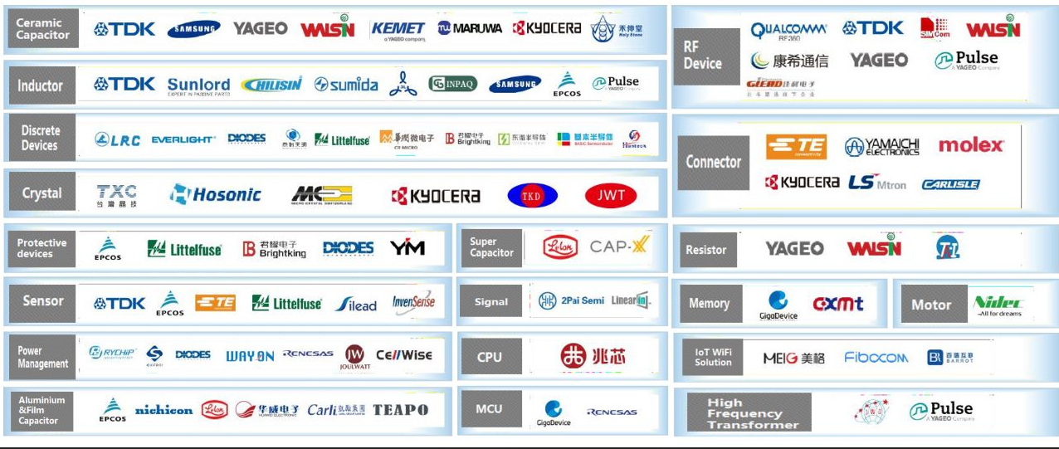
Line Items
BUY
SELL

Slide 4
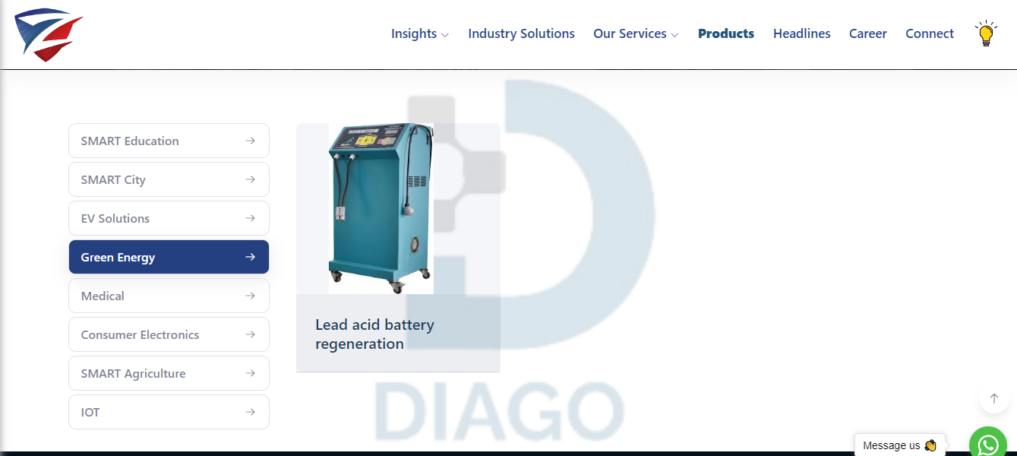
Manufacturers / Traders of
https://zillionlink.in/products
Lead Acid Battery Regenerator ( 85044030 ) I EV Battery charger ( 85044030 ) I Healthcare Devices ( 90181990 )

Slide 5
Buy Sell Platform
Pioneering ‘Consumer – Supplier’ online platform for Electronic Manufacturing & Service Industry . https://zillionlink.in/industrysolution . Log in – Register – Start earning
BUY
SELL

Slide 6
Thank You
CIN , GSTIN , PAN
U31909PN2022PTC214059 , 27AACCZ0407B1ZU , AACCZ0407B , IEC –AACCZ0407B
Connect Us :
Email : connect@zillionlink.in
Email : trade@zillionlink.in
Mob : (+91 ) – 8087232059 , 9145093943
www.zillionlink.in
Sn No 44/19, Plot no 4, Office Unit 2, First Floor Darshana Building, Narhe Industrial Estate , Pune,
Maharashtra, India, 411041

